Slide 1
KATE: K-Competitive Autoencoder for Text​
Yu Chen, Mohammed J. Zaki
Rensselaer Polytechnic Institute
Aug 15, 2017

Slide 2
Autoencoders for Text: Motivation
Task A
Task B
Task C
Output
Stage 2: downstream tasks
Learned embeddings can be used by any ML/DM model in relevant downstream tasks.
ML/DM
model
Embedding
Auto-encoders
Stage 1: representation learning
Automatically learns good features
(aka embeddings) in an unsupervised
manner.
Input
Notes:
As you know, traditional machine learning requires a lot of feature engineering which is difficult and expensive.
Representation learning aims to automatically learn good features in an unsupervised manner.
Those learned features are usually called as embeddings or representations.
We want the learned embeddings to capture some desired properties of the raw input data.
As a result, we can use the learned embeddings as the input features to our favorite ML/DM models
and expect they will work well in relevant downstream tasks.
The autoencoder is a class of powerful methods which can be used for representation learning.
Autoencoders have been successful in learning meaningful representations from image data.
However, their performance on textual data has not been widely studied.
In this talk, We will focus on applying autoencoders to text.
We will first target the issues of applying autoencoders to text
and then discuss a novel k-competitive autoencoder which was proposed to solve the issues.

Slide 3
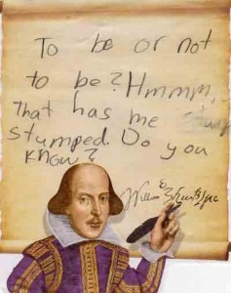
Autoencoders for Text: Overview
to
be
or
not
that
is
the
To be or not to be, that is the question.
question
Encoder
Decoder
Document
Bag of words
Embedding/code
Bag of words
Notes:
First of all, Let’s see what is an autoencoder.
An autoencoder is a neural network which consists of an encoder and a decoder.
Look at this example, given a document, we first map the text into the bag–of-words vector.
Then the bag-of-words vector will go through an encoder and be mapped into a low dimensional embedding space.
The decoder then tries to reconstruct the input vector from the squashed embedding.
The idea here is that we assume a good embedding should summarize the input text well enough that we can reconstruct the whole input precisely from the embedding.

Slide 4
Autoencoders for Text: Architecture
Input text document: a log-normalized word count vector
where each dimension is represented as:
where is the vocabulary and is the count of word
in that document.
Network definition:
Input
layer
We use the binary cross-entropy as the loss function:
Hidden
layer
Output
layer
Notes:
Let’s take a deeper look at autoencoders for text.
Each input document is represented as a log-normalized word count vector where each dimension is represented as follows.
Here, V is the vocabulary and ni is the count of word i in that document.
As for a basic one-hidden layer autoencoder, the encoder is simply a linear transformation of the input vector followed by some nonlinearity
while the decoder is another linear transformation applied to the embedding space followed by another nonlinearity.
In order to avoid overfitting, we usually set U as W^T, being an instance of weight tying.
The binary cross-entropy is used as the loss function.

Slide 5
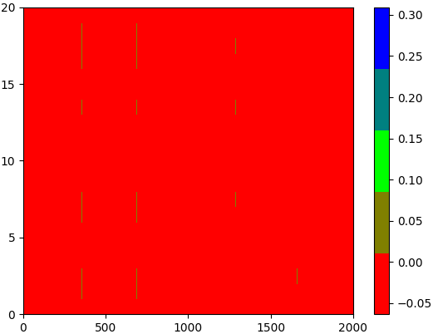
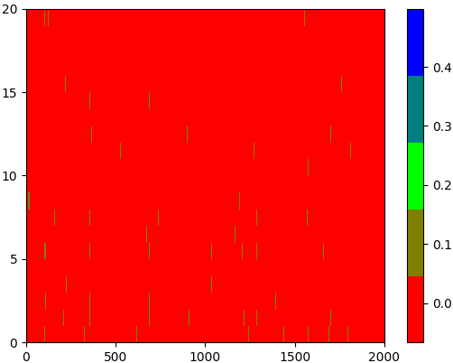
Autoencoders for Text: Issues
“year” dominates 8 topics
“year” dominates 4 topics
topics
topics
vocabulary
vocabulary
AE
KSAE
KSAE: explicitly enforces sparsity by only keeping the k highest activities in the feedforward phase.
“year” appears 3,990 times in the 20 Newsgroups training set.
Visualization of the normalized topic-word weight matrices of AE & KSAE.
Notes:
After applying autoencoders to text, we observed that traditional autoencoders had trouble dealing with textual data.
Here we show the visualization of the normalized topic-word weight matrices of AE and KSAE.
AE is the very basic one-hidden-layer autoencoder.
And KSAE stands for k-sparse autoencoder which explicitly enforces sparsity in the embedding space by only keeping the k highest activities in the feedforward phase.
Here, the topic-word weight matrix is exactly the hidden to input layer weight matrix.
We interpret each hidden neuron as a topic which directly interacts with the vocabulary in the input layer.
We trained both AE and KSAE on the 20 Newsgroups dataset. The vocabulary size is set as 2000 and the number of topics is set as 20.
As you can see from the two pictures, both AE and KSAE failed to learn “good” features from the corpus.
If you view the pictures vertically, you’ll find a few very frequent words dominate many topics.
For example, in AE, the word “year” which appears around 4000 times in the training set, dominates 8 out of 20 topics while in KSAE, the word “year” still dominates 4 topics.
If you view the pictures horizontally, you’ll find the extracted topics are not distinctive from each other (or we say, they are not quite diverse).
Here we only show the results of AE and KSAE, but we also observed similar results from other variants of autoencoders such as denoising autoencoders and contractive autoencoders.

Slide 6
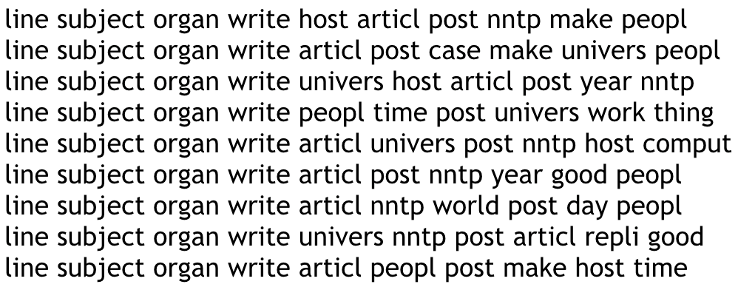
Challenges of Text
How to tackle the challenges?
Weighted loss?
Competition!
high-dimensionality
Topics: AE
Challenges
of Text
Sparsity
Topics: KSAE
Power-low distribution
A few very frequent words dominate the learned topics!
Notes:
We claim textual data is challenging for autoencoders because of the following facts.
Textual data is extremely high dimensional and sparse. The vocabulary size can be hundreds of thousands while the average fraction of zero entries in the bag-of-words vectors can be as high as 98%.
Furthermore, textual data typically follows a power-law word distribution which means a few very frequent words dominate the text.
Here are some sample topics learned by AE and KSAE. You can see a few very frequent words really dominate the learned topics.
We hypothesize that traditional autoencoders greedily learned trivial features in order to reconstruct every element in the input vector equally. And it seems that they only need to take care of a few highly frequent words since those words dominate the text.
So the question is how to tackle the challenges.
Some may suggest using weighted loss functions.
Well, it makes sense to decrease the impact of highly frequent words.
But in practice, we found it did not help much.
Autoencoders still chose to greedily learn indistinctive patterns.
Since our goal is to learn distinctive patterns which can capture different aspects of the input data, we instead choose to force autoencoders to achieve this by bringing competition to the training phase.

Slide 7
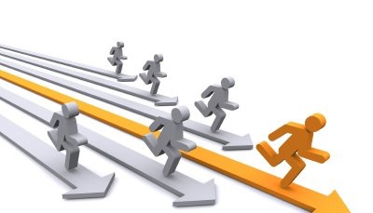
Competitive Learning
Competition leads to distinctiveness!
Notes:
Intuitively, one of the best ways to have distinctive or diverse individuals is to let them compete.
After competition, there will be winners and losers. Someone might be better at one thing, while someone else might be better at another.
We introduce this idea of competitive learning to autoencoders, specifically, we force hidden neurons to compete for the right to respond to a subset of the input data.

Slide 8
KATE: Bringing Competition among Neurons in the Hidden Layer
tanh
0.8
0.8+0.3a
The energy of H:
0.2
0
0.1
0
0.3
“Matthew effect”: the strong get
stronger and the weak get weaker.
The amplification connection
is crucial for KATE!
-0.4
-0.1
0
-0.3
0
Specialized neurons &
distinctive (diverse) patterns!
When , no gradient will flow
through loser neurons.
When , we boost the
gradient signal flowing
through the loser neurons.
-0.6
0.6-0.4a
Input
layer
K-Competitive
layer
Output
layer
Notes:
Let’s take a deeper look at this.
Here is a very simple one-hidden-layer autoencoder with tanh activation function in the hidden layer.
In each step of feedforward, there are positive and negative neurons in the hidden layer.
We claim that both the positive and negative hidden neurons are equally important since they capture the positive and negative patterns of the input data, respectively.
If we interpret each hidden neuron as a topic, a positive neuron represents the presence of a topic in an input document while a negative neuron represents the absence of a topic.
Let’s look at positive neurons for now.
In this step of feedforward, we have three positive hidden neurons which are h1, h2 and h3.
We select, for example, the top one most competitive neuron as the winner, which is h1 in our case.
The remaining neurons h2 and h3 are loser neurons in this example.
Here we define the most competitive neuron as the one which has the largest absolute value of activities.
In short, the way we introduce competition is to let the winner neurons take away the energy of loser neurons
where the energy is defined as the sum of the absolute values of the activations for a set of neurons.
In this example, the energy of loser neurons is 0.3.
Now, we amplify and reallocate the energy of loser neurons among the winners using an α amplification connection.
Thus, the new value of h1 is 0.8+0.3a and all the losers are further made inactive.
Similarly, h6 is the negative winner, and it incorporates the amplified energy from the negative loser neurons h4 and h5.
h4 and h5 are made inactive in this step of feedforward.
You will see the design of this k-competitive autoencoder follows the general philosophy of the Matthew effect which says the strong get stronger and the weak get weaker.
As a result, each hidden neuron is strong on recognizing specific data patterns and overall the model can learn diverse patterns and meaningful representations of the input data.
When we do back-propagation, the gradients will first flow through the winner neurons in the hidden layer and then the loser neurons via the α amplification connections.
No gradients will flow directly from the output neurons to the loser neurons since they are made inactive in the feedforward step.
We argue that the a amplification connection is crucial for KATE.
When a = 0, no gradient will flow through loser neurons.
When a > 2/k, we actually boost the gradient signal flowing through the loser neurons.
Here k is the pre-defined total number of winner neurons including the positive and negative winners.

Slide 9
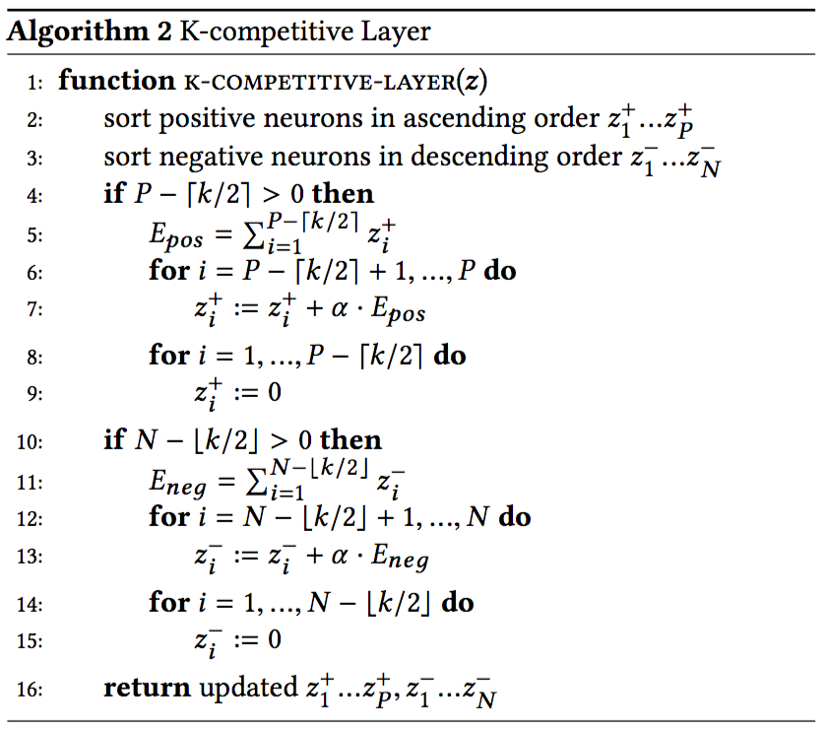
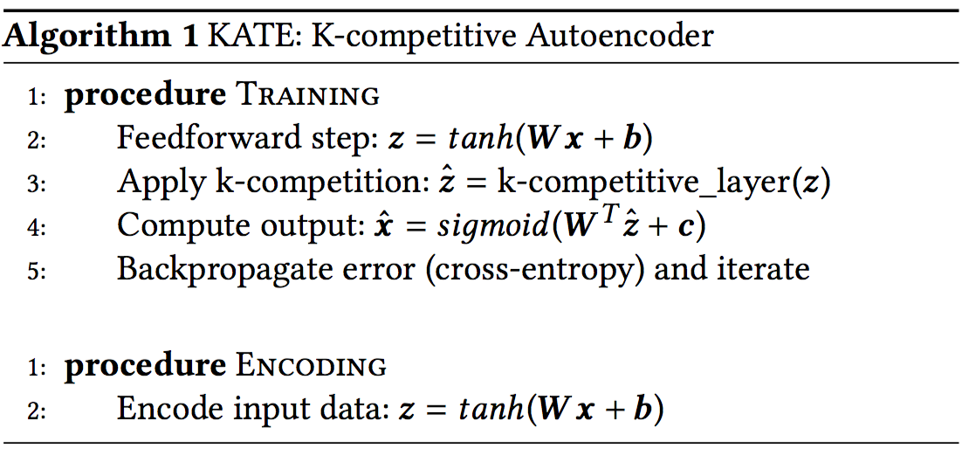
KATE: Algorithm
No competition in the encoding step!
: the number of positive winner neurons.
: the number of negative winner neurons.
Notes:
Here is the pseudo-code of the KATE algorithm.
The only difference between KATE and the basic autoencoder is that KATE applies a k-competitive layer instead of a normal fully connected layer in the middle.
Once the k-competitive network has been trained, we simply map each test input to the embedding space.
No competition is required for the encoding step since the hidden neurons are well trained to be distinctive from others.
We argue that this is one of the superior features of KATE.
And we will verify this argument shortly.
Here is the detailed algorithm of the k-competitive layer.
we set a hyper parameter k as the total number of winner neurons.
We select k/2 positive winner neurons and k - k/2 negative winner neurons.

Slide 10
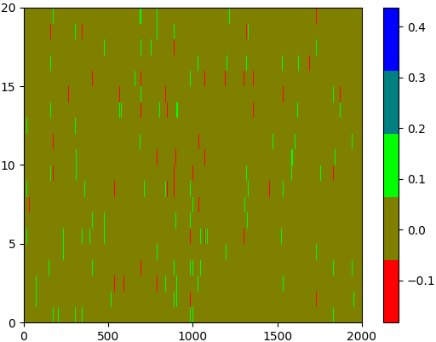
KATE: Learning Distinctive Patterns
“year” dominates 2 topics
“year” dominates 3 topics
topics
topics
vocabulary
vocabulary
KATE
LDA
Visualization of the normalized topic-word weight matrices of KATE & LDA.
Notes:
Here we show the visualization of the normalized topic-word weight matrices of KATE and LDA.
As you can see, KATE can learn more diverse patterns than AE and KSAE.
In KATE, the word “year” dominates only 2 topics, which is even better than LDA in which the word “year” dominates 3 topics.

Slide 11
KATE: Learning Distinctive Patterns (cont’d)
Model | 20 Newsgroups
 | 20D | 128D | 512D
AE | 0.976 | 0.722 | 0.319
KSAE | 0.268 | 0.198 | 0.056
LDA | 0.249 | 0.059 | 0.028
KATE no_amp. | 0.154 | 0.069 | 0.037
KATE | 0.097 | 0.024 | 0.014
Mean Squared Cosine Deviation among topics:
Note: KATE no_amp. stands for KATE
without amplification (i.e., ).
The default value of is set as 6.26.
The amplification connection
controls the level of competition.
Mean squared cosine deviation among topics;
smaller means more distinctive topics.
Notes:
In order to quantitatively verify that KATE can learn more distinctive patterns than other autoencoders,
we introduce a new metric called mean squared cosine deviation (MSCD) to evaluate how diverse learned topics are.
This metric basically computes how close the angle between two topic vectors is to 90 degrees.
Since 90 degrees means that two topics are orthogonal, a smaller value of MSCD means more distinctive topics.
We can see that KATE is able to learn much more distinctive patterns than AE, KSAE and even LDA.
We can also conclude that the a amplification connection helps learn more distinctive topics, considering the fact that KATE with amplification consistently achieves lower MSCD values than KATE without amplification.
It makes sense since intuitively the a amplification connection can control the level of competition and a higher level of competition leads to more distinctive topics.

Slide 12
Experiments: Datasets
Dataset | 20 Newsgroups | Reuters RCV1-v2 | Wiki10+ | Movie Review Data
Train.Size | 11,314 | 554,414 | 13,972 | 3,337
Test.Size | 7,532 | 250,000 | 6,000 | 1,669
Valid.Size | 1,000 | 10,000 | 1,000 | 300
Vocab.Size | 2,000 | 5,000 | 2,000 | 2,000
Avg.Length | 93 | 112 | 1,299 | 124
Classes/Values | 20 | 103 | 25 | [0,1]
Task | class & DR | MLC | MLC | Regression
Datasets: Tasks include classification (class), regression,
multi-label classification (MLC) and document retrieval (DR).
Notes:
Here we show the summary of the datasets used in our experiments.
We evaluate the quality of learned document representations in terms of several downstream tasks
including classification, regression, multi-label classification and document retrieval.

Slide 13
Experiments: Baselines
Method | Description | Category
LDA (Latent Dirichlet Allocation) | Classical topic modeling method. | Probabilistic topic models
DBN (Deep Belief Networks) | A direct acyclic graph whose top two layers form a restricted Boltzmann machine. | Deep generative models
DocNADE | A neural autoregressive topic model that can be used for extracting meaningful representations of documents.
Word2Vec | A model in which each document is represented as the average of the word embedding vectors for that document. | Word representation models
Word2Vec_pre | Pre-trained word embeddings which contain 300-dimensional vectors for 3 million words and phrases from Google News.
Doc2Vec | A distributed representation model inspired by Word2Vec which can directly learn vector representations of documents.
AE | A basic one-hidden-layer autoencoder. | Autoencoders
DAE (Denoising AE) | A denoising autoencoder that accepts a corrupted version of the input data while the output is still the original uncorrupted data.
CAE (Contractive AE) | A contractive autoencoder which introduces the Frobenius norm of the Jacobian matrix of the encoder activations into the regularization term.
VAE (Variational AE) | A generative autoencoder inspired by variational inference.
NVDM | A neural variational inference model for document modeling.
KSAE (K-Sparse AE) | A competitive autoencoder which explicitly enforces sparsity by only keeping the k highest activities in the feedforward phase.
Summary of baselines.
Notes:
Our baseline methods include autoencoders, probabilistic topic models, deep generative models and word representation models.

Slide 14
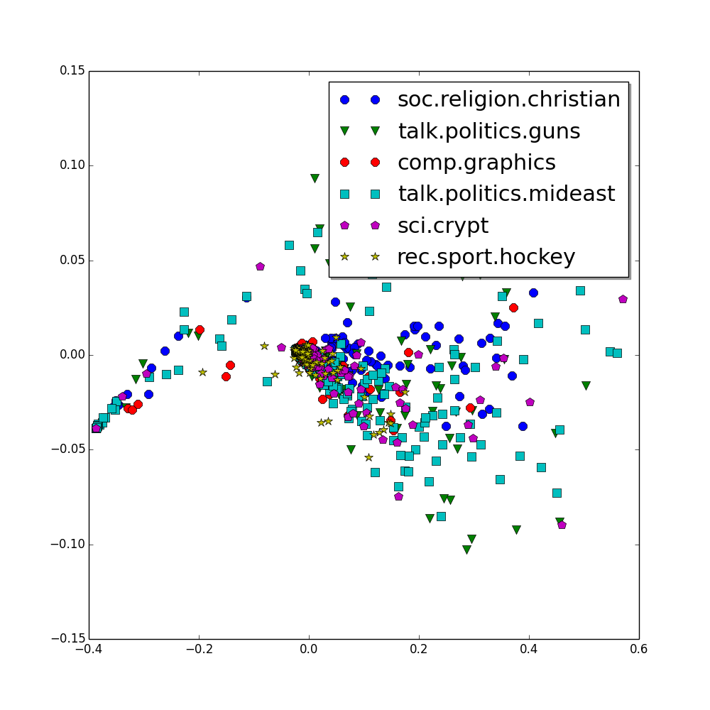
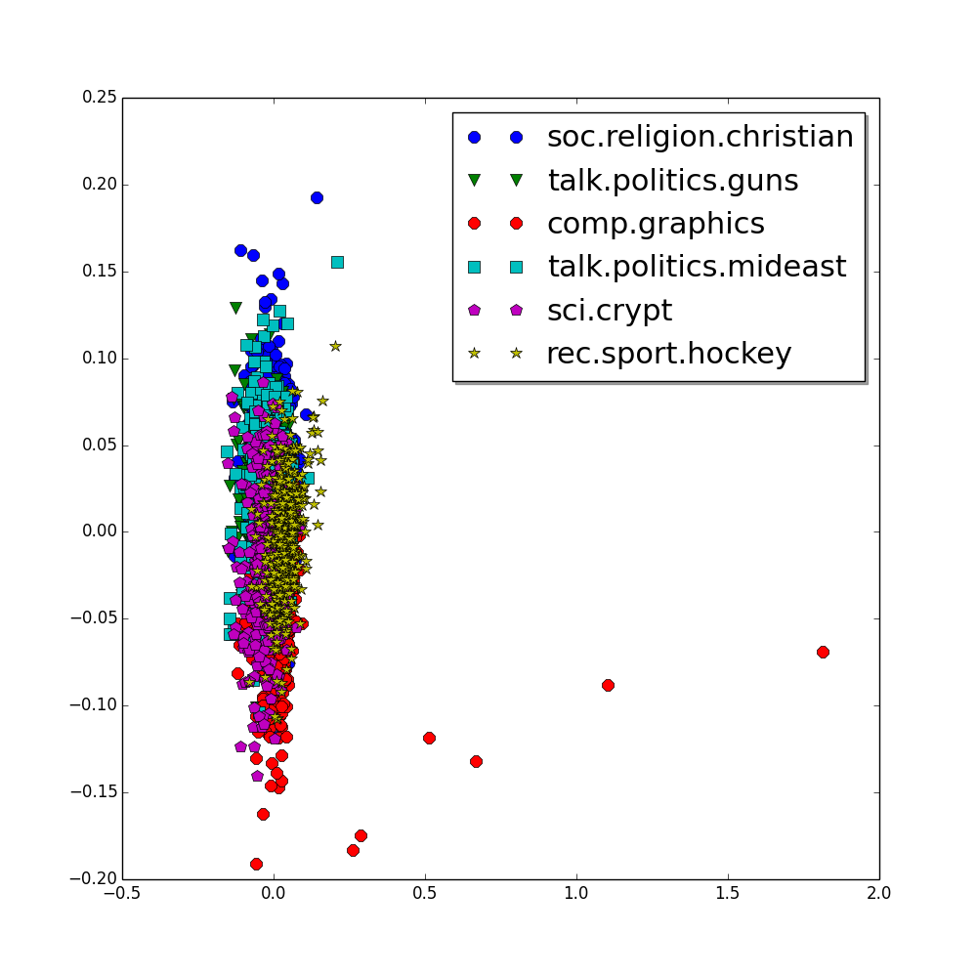
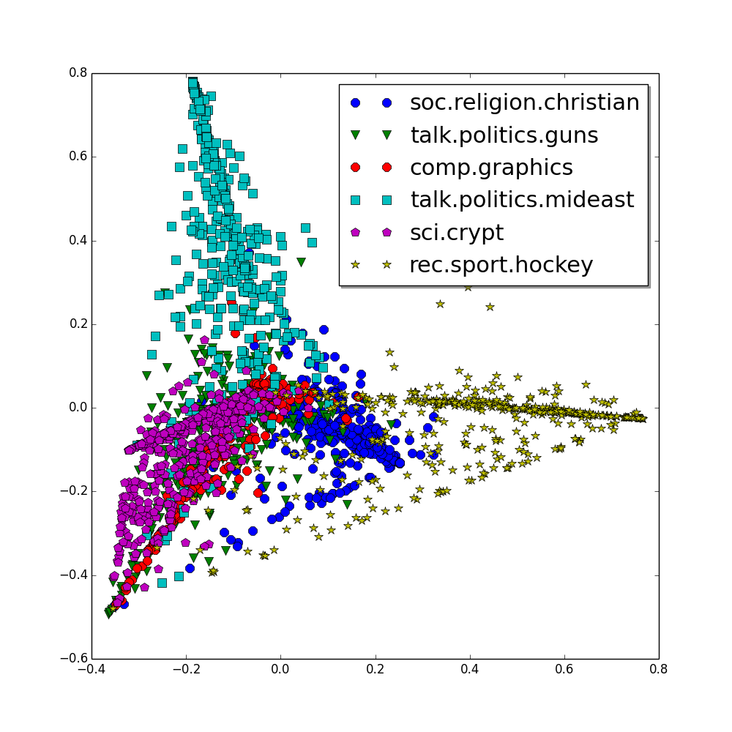
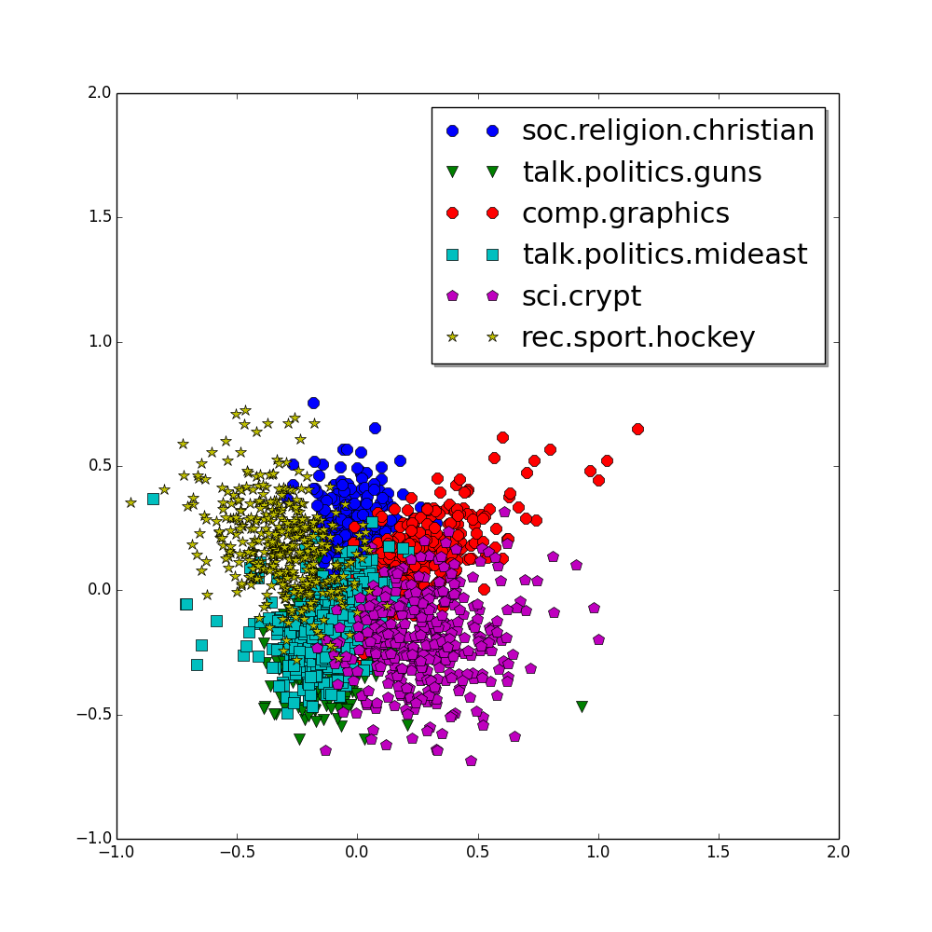
Experiments: Visualization of Learned Document Representations
AE
KSAE
LDA
KATE
PCA on the 20-dimensional document representations from the 20 Newsgroups dataset.
Notes:
Here we show the PCA projections of document representations learned by various models taken from the six main groups in the 20 Newsgroups dataset.
As we can observe, neither AE nor KSAE can learn good document representations.
On the other hand, KATE successfully clusters related documents in the same group, and it can easily distinguish the six different groups.
In fact, KATE even performs slightly better than LDA.

Slide 15
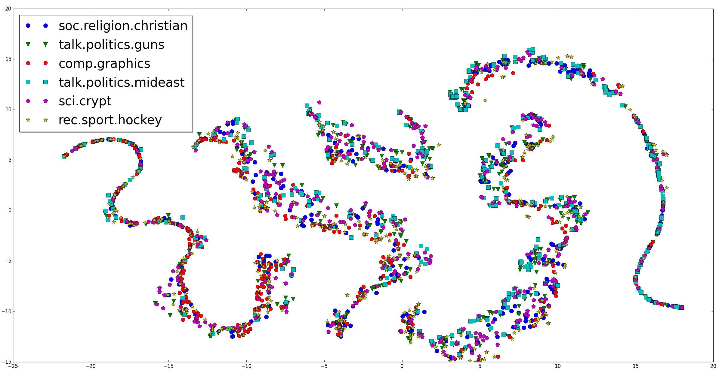
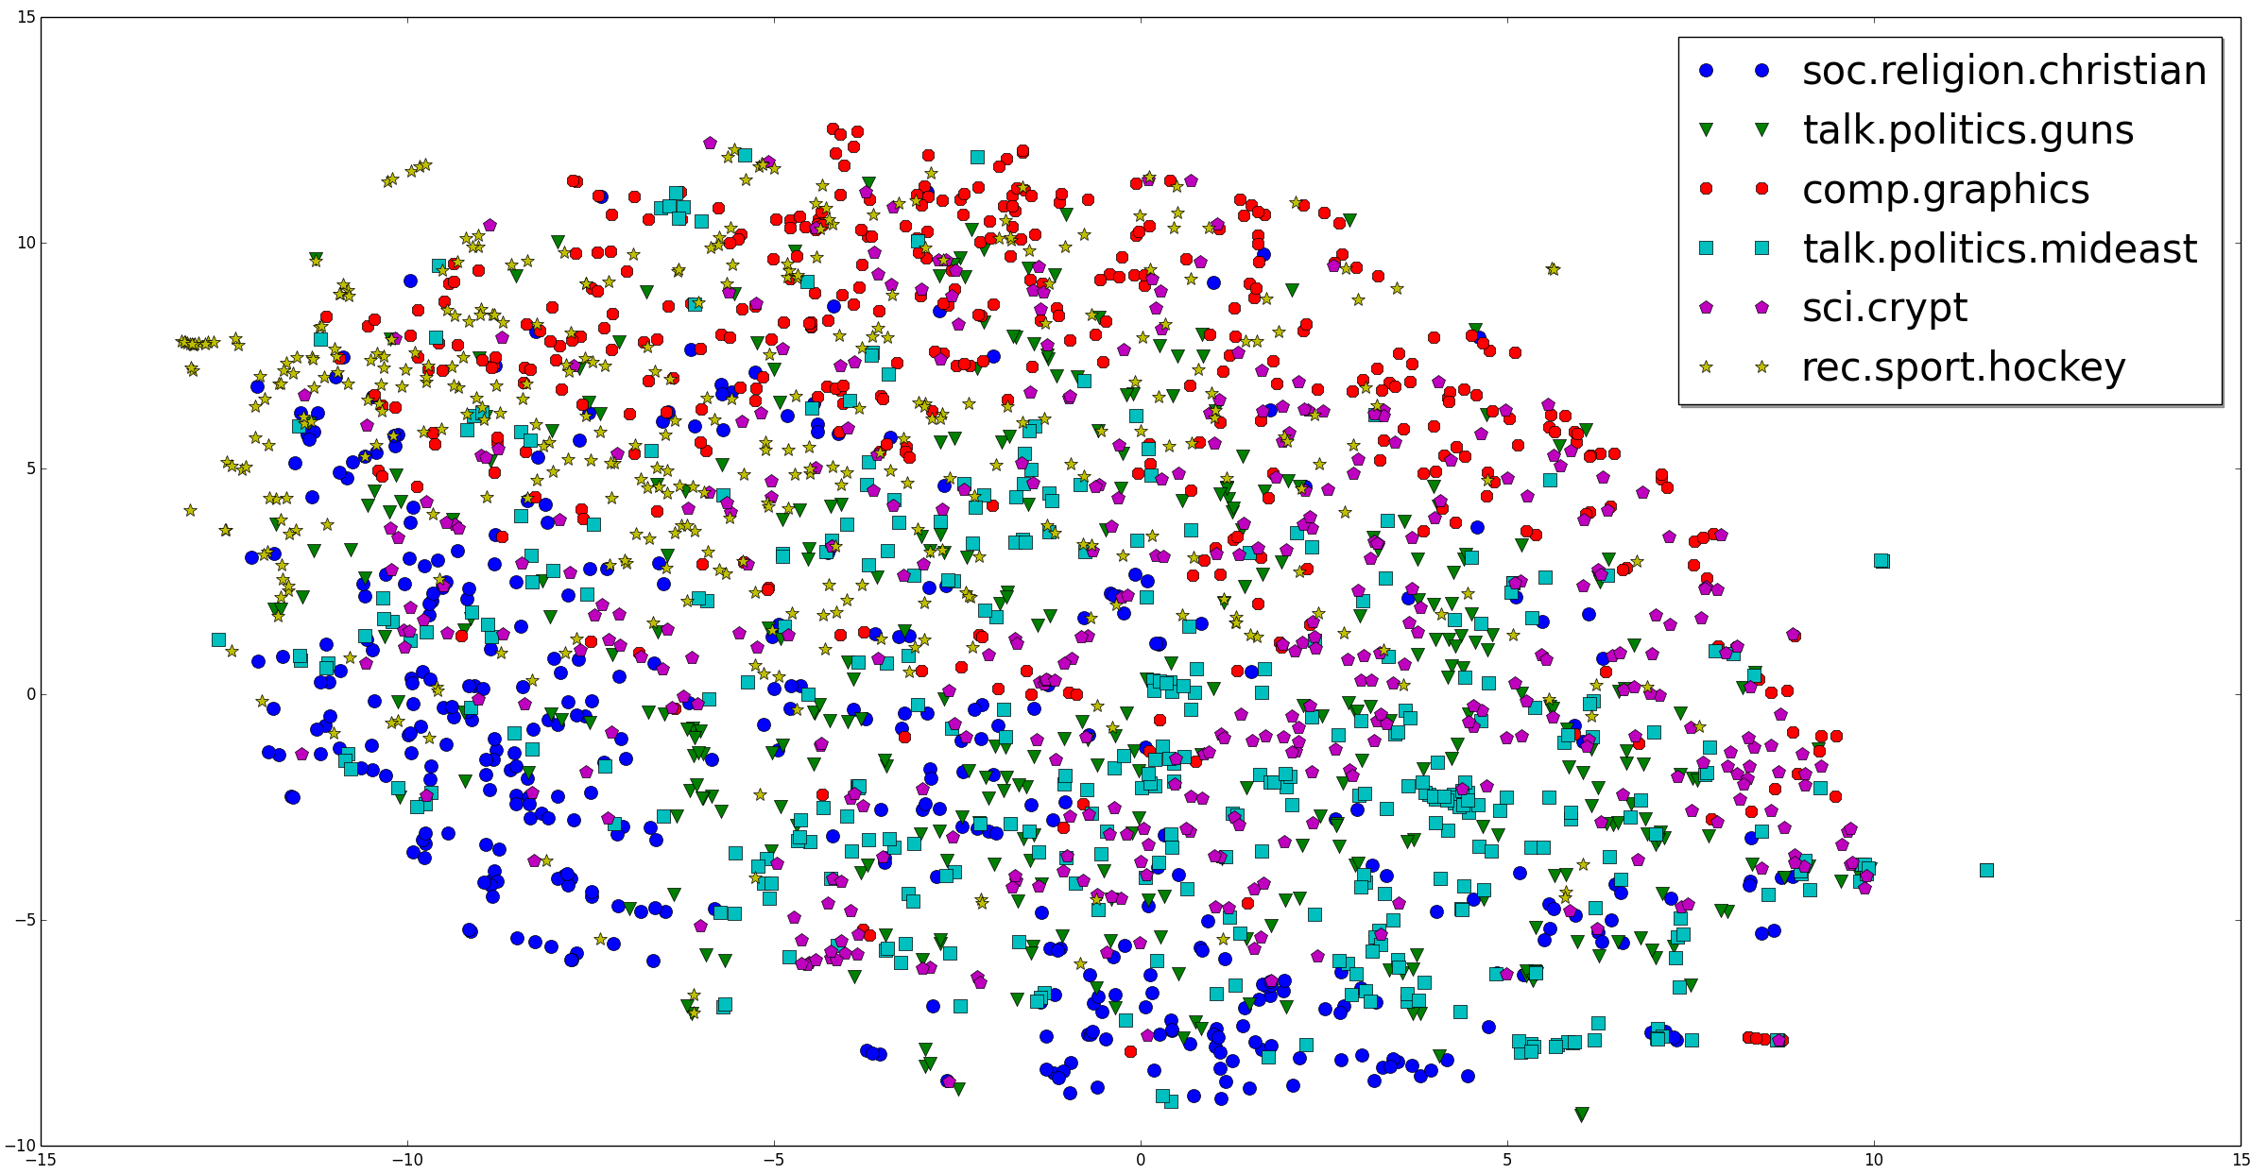
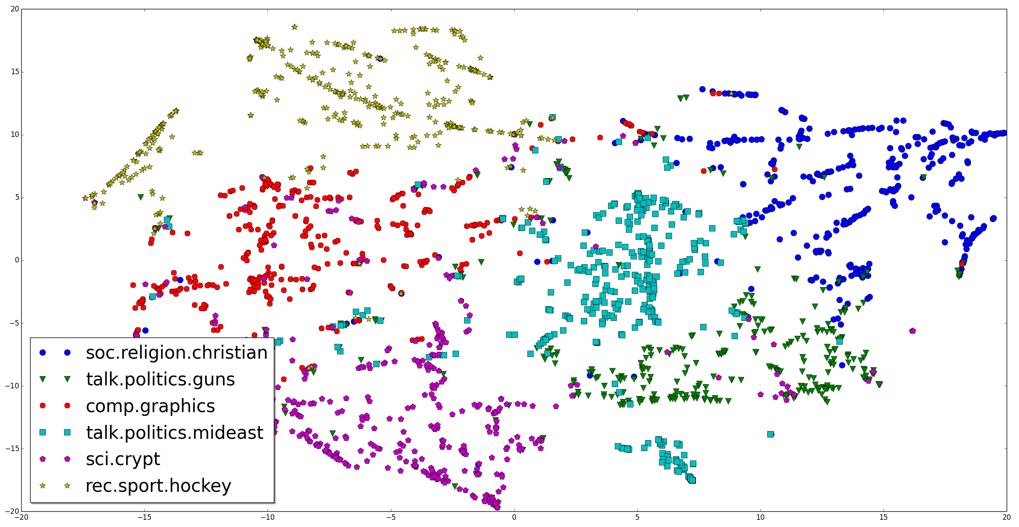
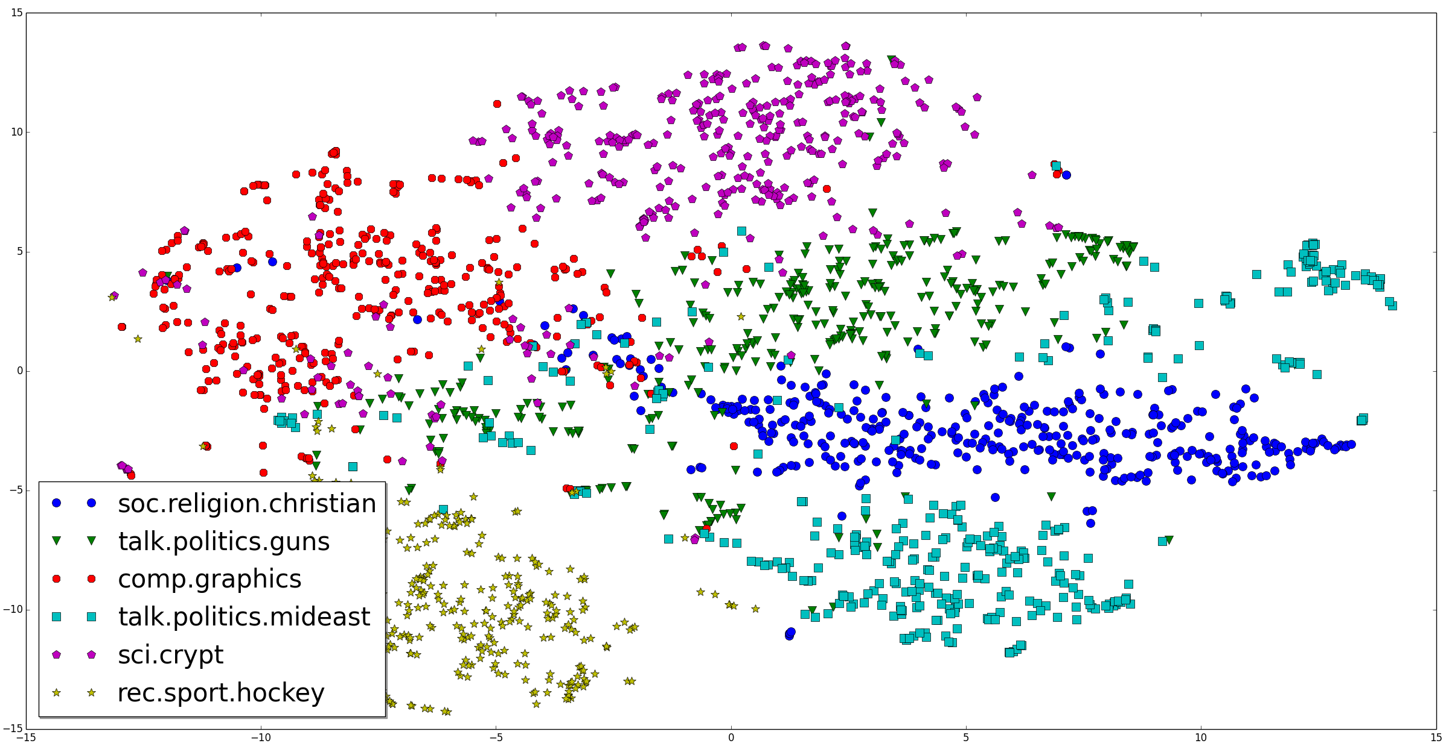
Experiments: Visualization of Learned Document Representations (cont’d)
AE
KSAE
LDA
KATE
T-SNE on the 20-dimensional document representations from the 20 Newsgroups dataset.
Notes:
Here we show the T-SNE based visualization of the above document representations and we can draw a similar conclusion.

Slide 16
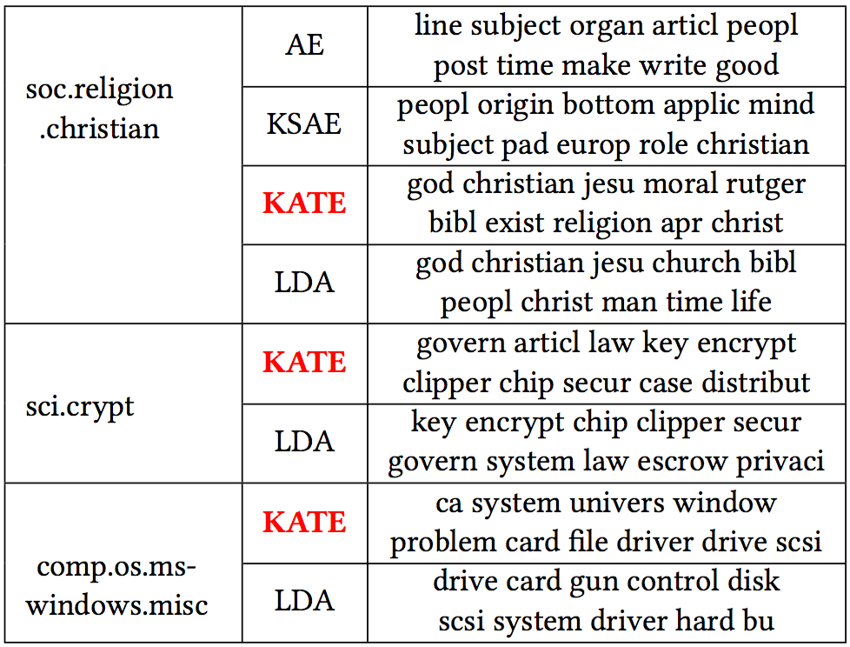
Experiments: Topics Learned by Various Models
AE-like models:
hidden-input weight matrix.
LDA:
topic-word distribution.
Topics learned by various models from the 20 Newsgroups dataset.
Notes:
Here we examine topics learned by various models from the 20 Newsgroups dataset.
As we have already seen, AE and KSAE fail to extract meaningful topics.
However, KATE generates competitive topics compared with LDA, and which are distinctive from each other and capture the underlying semantics very well.

Slide 17
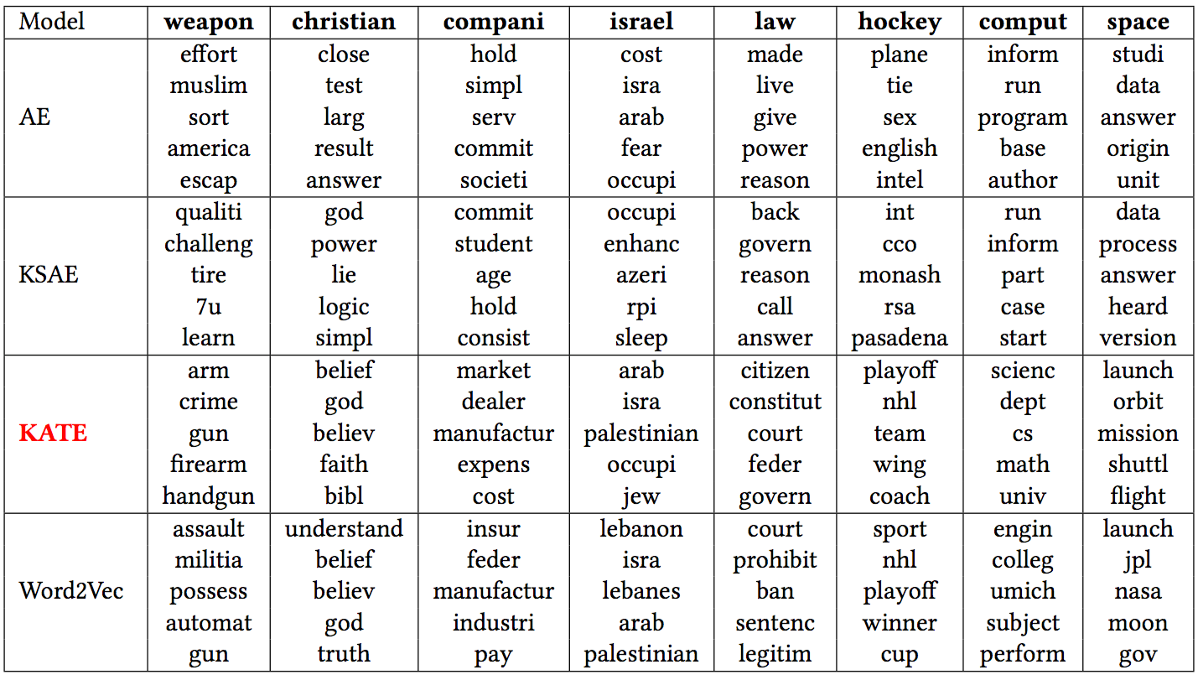
Experiments: Word Representations Learned by Various Models
AE-like models:
input-hidden
weight matrix.
Five nearest neighbors in the 20-D word representation space on the 20 Newsgroups dataset.
Notes:
In order to evaluate whether KATE can learn semantically meaningful word representations, we check if similar or relevant words are close to each other in the vector space.
This table shows the five nearest neighbors for some query words in the word representation space learned by AE, KSAE, KATE and word2vec.
We can observe that KATE can learn competitive word representations compared to Word2Vec in terms of this word similarity task,
while neither AE nor KSAE is able to find relevant words given a query word.
//For example KATE lists words like arm, crime, gun, rearm, handgun among the nearest neighbors of query word weapon.

Slide 18
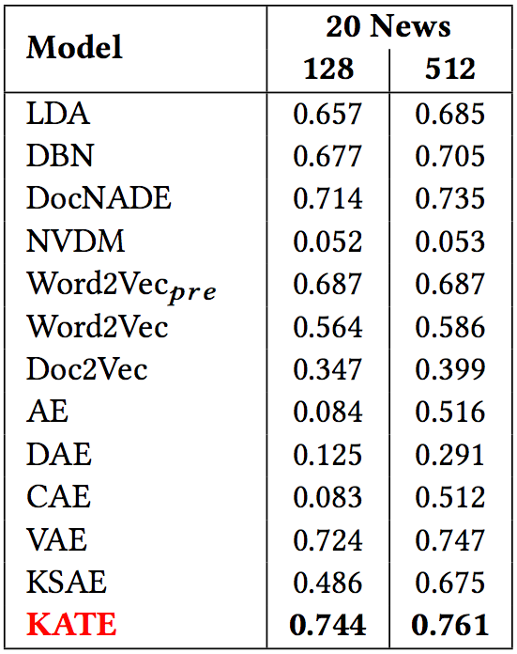
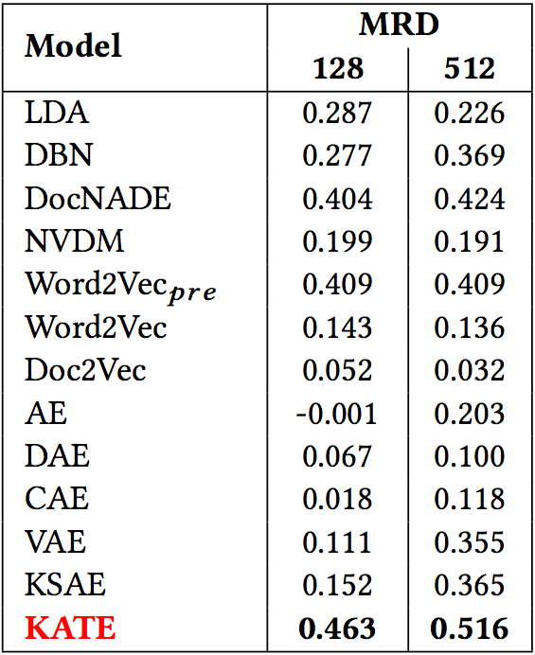
Experiments: Evaluating Learned Document Representations
Classification accuracy on the 20 Newsgroups dataset.
Comparison of regression score on the MRD dataset.
Notes:
Here, we evaluate the quality of learned document representations from various models for the purpose of document classification and regression.
We train a simple two-layer neural network that uses the learned document representations as feature vectors, and directly maps them to the output classes or values.
As we can see, KATE significantly outperforms all other models across different tasks and datasets.

Slide 19
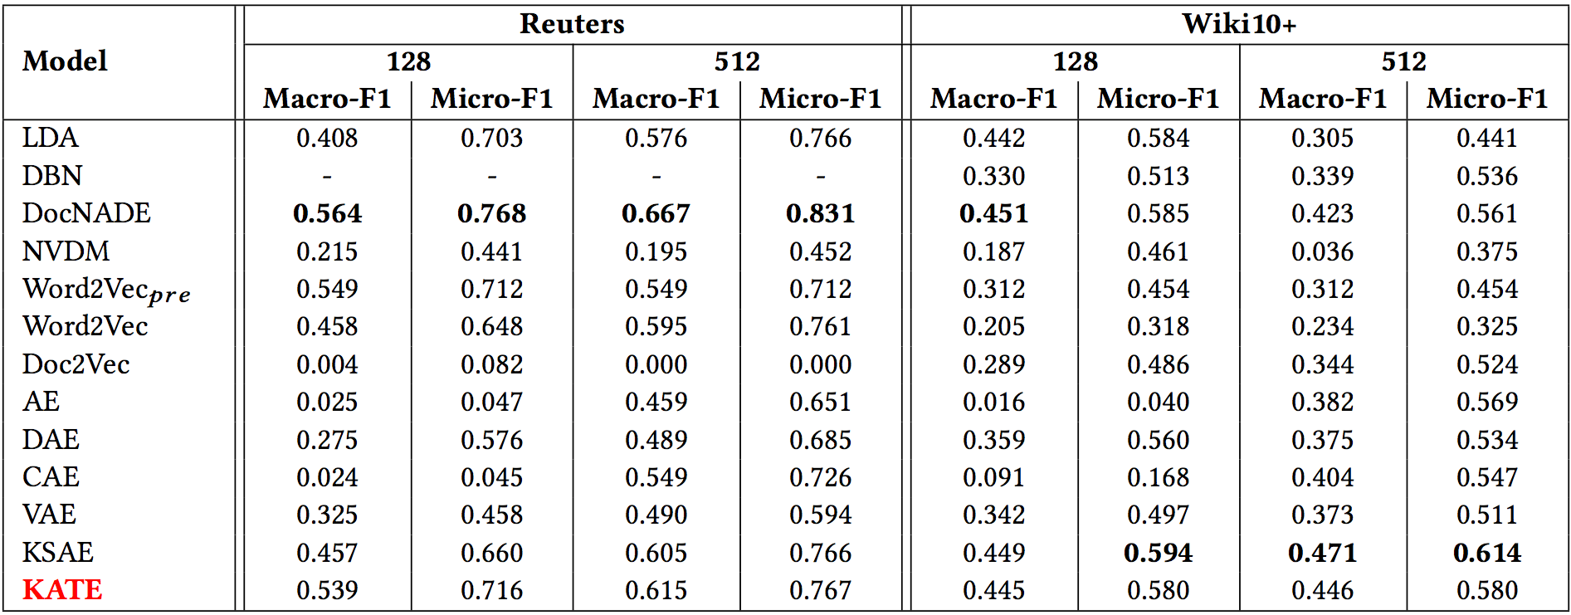
Experiments: Evaluating Learned Document Representations (cont’d)
Comparison of MLC F1 score on the Reuters RCV1-v2 and Wiki10+ datasets.
Notes:
Here we show the multi-label classification results on Reuters and Wiki10+ datasets.
DocNADE works very well on this task.
KATE outperforms KSAE on Reuters and remains competitive on Wiki10+.

Slide 20
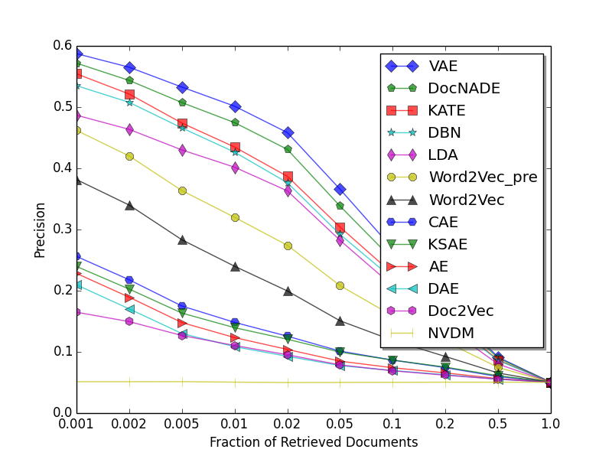
Experiments: Evaluating Learned Document Representations (cont’d)
Document retrieval on the 20 Newsgroups dataset (128 features).
Notes:
We also evaluate the various models for document retrieval.
Given a query document, we fetch the relevant documents based on the cosine similarity between the document representations.
In this task, VAE performs the best followed by DocNADE and KATE.
Other autoencoders are not that effective.
(Each document in the test set is used as an individual query and we fetch the relevant documents from the training set based on the cosine similarity between the document representations.
The average fraction of retrieved documents which share the same label as the query document, was used as the evaluation metric.)

Slide 21
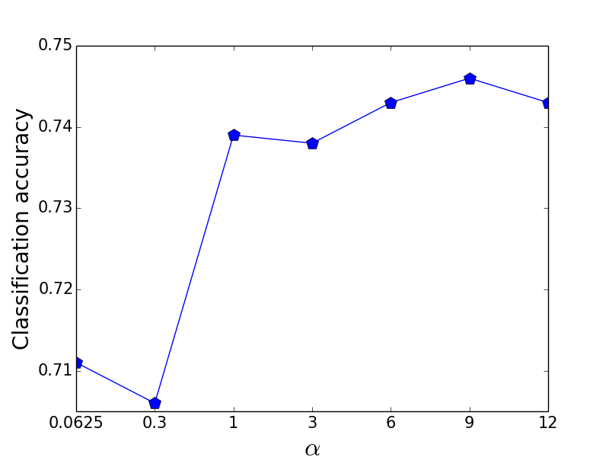
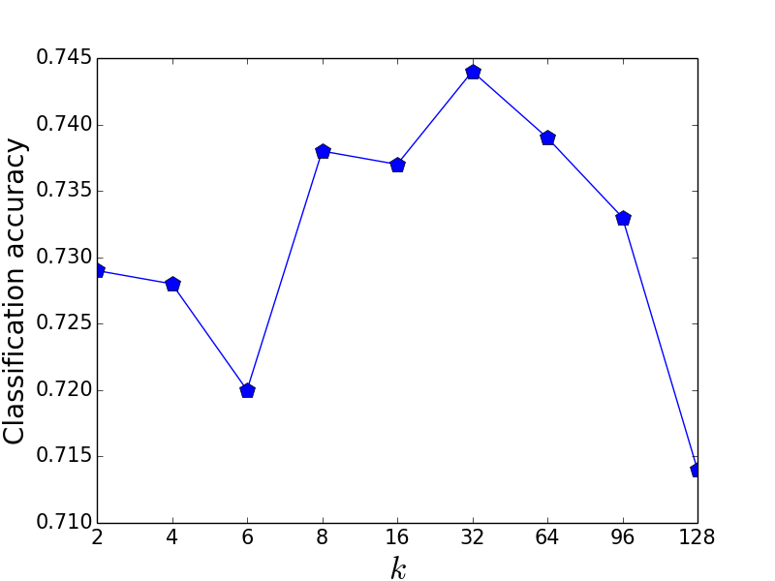
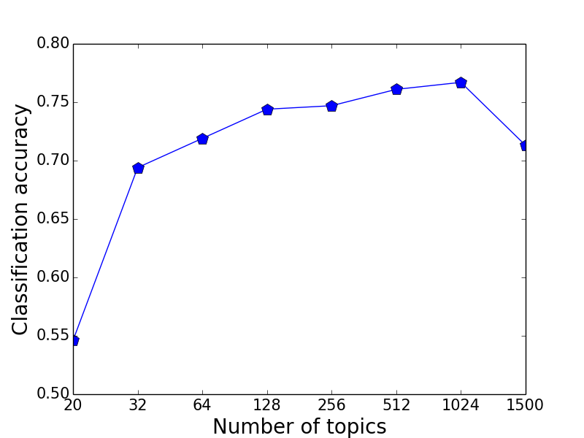
Experiments: Effects of hyper-parameters.
Effects of hyper-parameters; classification accuracies reported on the 20 Newsgroups dataset.
Notes:
Finally, we study the effects of various hyper-parameters in KATE which we can play with.

Slide 22
Summary
Traditional autoencoders have trouble with textual data.
KATE is capable of extracting distinctive patterns by making hidden neurons compete with each other.
KATE can learn better representations than traditional autoencoders including AE, DAE, CAE, VAE and KSAE.
KATE outperforms deep generative models, probabilistic topic models and word representation models in terms of several downstream tasks such as document classification, regression, and retrieval.
Notes:
Let’s try to summarize.
Traditional autoencoders have trouble with textual data.
KATE is capable of extracting distinctive patterns by making hidden neurons compete with each other.
KATE can learn better representations than traditional autoencoders.
KATE outperforms deep generative models, probabilistic topic models and word representation models
in terms of several downstream tasks.

Slide 23
Future Work
K-competitive autoencoders for image.
Deep k-competitive autoencoders.
Other alternatives to bringing competition among neurons.
Notes:
As part of the future work,
here are a few things we would like to do.
We have tried applying KATE on image data but it was not that effective.
But we would like to dig it deeper.
KATE is a one-hidden-layer neural network.
We would like to see if it can enjoy the “benefits of depth” which has been widely observed in the field of deep learning.
Since bringing competition into neural networks is an interesting topic and might be helpful for some tasks,
we would like to try other alternatives to doing that.

Slide 24
Thank you!
Q&A
Notes:
Thanks for listening.
Please feel free to ask any question.

